Slide 1

APPLICATION OF LIDAR IN ADAS
GUIDE: SILPA AJITH KUMAR
DONE BY: SUKANYA DEKA
1DS17EI036
Department of Electronics and Instrumentation Engineering

Slide 2
OBJECTIVE
Application of Light Detection and Ranging in Advanced driver-assistence systems.
Advantages of using LiDAR in ADAS
LiDAR sensors use an eye-safe laser to emit light pulses which light up the desired area.
They function independently of the ambient lighting.

Slide 3
What is ADAS?
Advanced driver assistance systems (ADASs) are accelerating the growth of infrared (IR) devices used in automotive applications.
Vehicle detection is important for advanced driver assistance systems (ADAS)
Collision avoidance from obstacle recognition is the most important feature in ADAS (Advanced Driver Assistance System),

Slide 4
Applications of ADAS
Automated adaptation and enhancement of safety systems to improve driving among the population.
ADAS are intended to avoid collisions by using technologies to alert drivers to potential hazards or take over control of the vehicle to avoid such danger.
Adaptive features like automated lighting, adaptive cruise control, and pedestrian crash avoidance mitigation (PCAM).
Sensors have the potential to self-calibrate in the future to focus on the inherent safety and dependability of these systems.

Slide 5
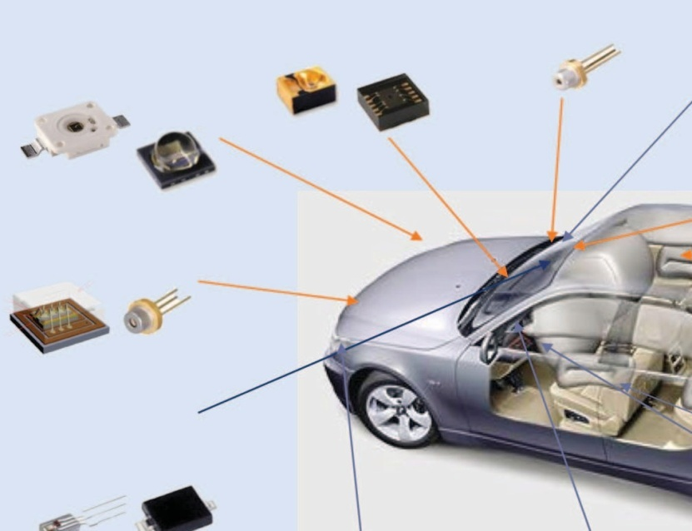
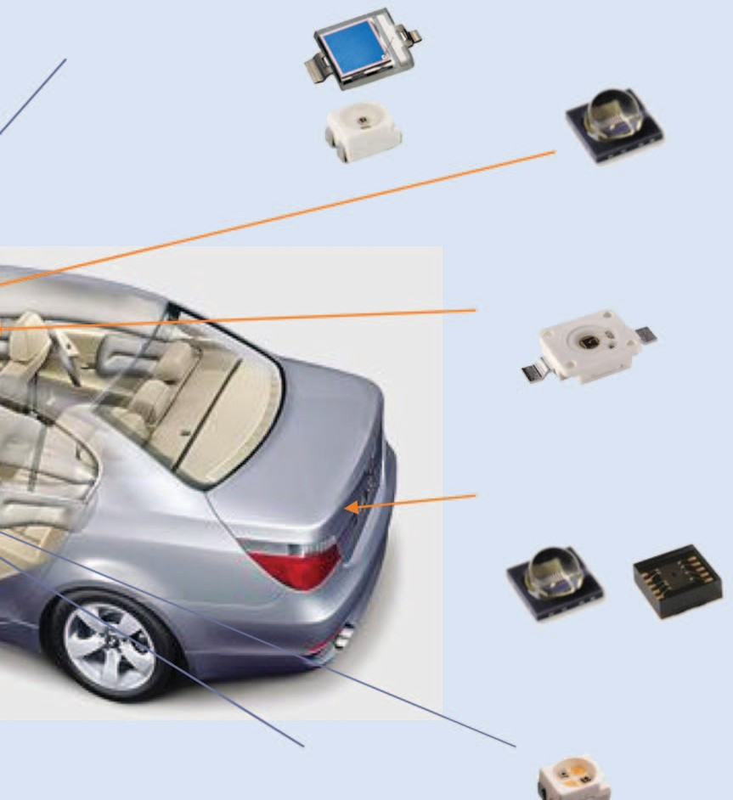
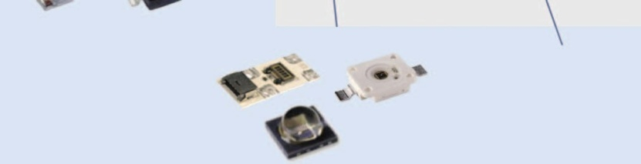

Camara-Based Pedestrian Protection
Gesture Recognition
Laser Head-Up Display
Rain Sensor Tunnel Sensor Optical Switches
Driver Monitoring
Seat Occupancy Detection
Blue Lasers for Headlamps
Trunk Opener/ Rear Safety
Precrash System/ Autonomous Driving
Immobilizer IR Key
IR-Based Night Vision
Ambient Light Sensors
Dashboard
Car Radio
Displays
Steering Wheel Angle Sensor
Existing Applications
Future Applications
IR sensing devices with automotive use cases.

Slide 6
LiDAR
LiDAR acts as an eye of the self-driving vehicles providing them a 360-degree view.
LiDAR is also widely used for ADAS related applications. It provides high precision range information with wide fields of view.
Vehicles of all types use LiDAR to determine which obstacles are nearby and how far away they are.

Slide 7
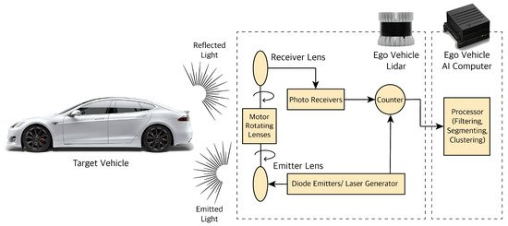
Block Diagram of the Proposed System

Slide 8
Why we need LiDAR
Within the past few years, vehicle detection has become an important task for advanced driver assistance systems (ADAS)
Reverse Parking Assistance, Driver Drowsiness detection and Rear Cameras view.
LiDAR, in contrast, offers precise 3D measurement data over short to long ranges, even in challenging weather and lighting conditions.

Slide 9
A comparison of radar, camera, and LIDAR technologies. A comparison of radar, camera, and LIDAR technologies.
Table 1. A comparison of radar, camera, and LIDAR technologies.
All three have limitations—optimum fusion determined by regulation/consumer expectations. Typical Azimuth 2015 Price Sensor Range FOV Range Typical Applications Comments
24-GHz RADAR | 60 m1 | 56°1 | US$80–100 | Blind-spot detection Forward collision warning | USA bandwith 100–250 MHz2; robust for rain/snow; concerns for people detection/angular resolution
77-GHz RADAR | 200 m1 | 18°1 | US$150–175 | Adaptive cruise control Forward collision warning | USA bandwith 600 MHz2; robust for rain/snow; concerns for people detec- tion/angular resolution
Front Mono Camera | 50 m1 | 36°1 | US$80–100 | Lane departure warning Forward collision warning Traffic sign recognition | Versatile sensor (applications); limited depth perception, affected by rain/fog; needs illuminations (visible/IR)
LIDAR (Flash) | 50 m | 56° | US$60–100 US$60–100 | Blind-spot detection Forward collision warning | Concerns for rain/snow; good reflection off people with angular resolution; range and S/N limited by eye safety
LIDAR (Scanning) | 120 m | 360°1 | US$100–500 | Mapping environment BSD/FCW/LDW/ACC | Concerns for rain/snow; typically higher price for angular resolution; range and S/N limited by eye safety
False positives " Nuisance to consumer " Turns feature off (if possible) False negatives " did not meet spec/expectations => Optimum combination of sensors will be a learning process 1: J. Harding et al., “Vehicle to vehicle communications: Readiness of V2V technology for application,” National Highway Traffic Safety Administration, Washington, D.C., Rep. DOT HS 812014, 2014, Table V-7. 2: D. Kissenger, Millimeter Wave Receiver Concepts for 77 GHz Automotive Radar in Silicon Germanium Technology. New York: Springer, 2012.
A comparison of radar, camera, and LIDAR technologies.

Slide 10
References
Feihu Zhang, Daniel Clarke, Alois Knoll,” Vehicle Detection Based on LiDAR and Camera Fusion” 2014 IEEE 17th International Conference on Intelligent Transportation Systems (ITSC) October 8-11, 2014.
Abhir Naik,” LiEBiD - A LIDAR based Early Blind Spot Detection and Warning System for Traditional Steering Mechanism (ICOSEC 2020) IEEE Xplore Part Number: CFP20V90-ART; ISBN: 978-1-7281-5461-9.
Rajeev Thakur,” Scanning LIDAR in Advanced Driver Assistance Systems and Beyond” Date of publication: 10 August 2016.

Slide 11
THANK YOU

